Slide 1
Introduction to R for Machine Learning
ACM Data Science Camp 2015
Joseph B Rickert & Robert Horton
Microsoft

Slide 2
Agenda
What is R?
The R Package System
Learning R
R Basics
Machine Learning Examples
Scaling up with RRE and Azure
Some Resources for Continued Learning

Slide 3
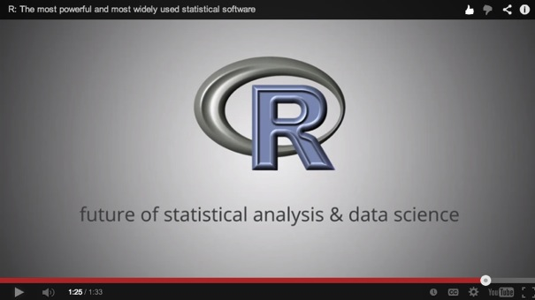
What is R?
Most widely used data analysis software
Used by 2M+ data scientists, statisticians and analysts
Most powerful statistical programming language
Flexible, extensible and comprehensive for productivity
Platform for beautiful and unique data visualizations
As seen in New York Times, The Economist and FlowingData
Thriving open-source community
Leading edge of analytics research
New graduates prefer R
www.revolutionanalytics.com/what-is-r

Slide 4
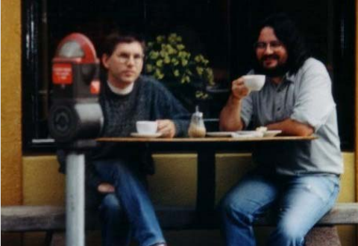
A brief history of R
1976: John Chambers and colleagues at Bell Labs begin working on S
1993: Research project in Auckland, NZ
Ross Ihaka and Robert Gentlemen
1995: Released as open-source software
Generally compatible with the “S” language
1997: R core group formed
2000: R 1.0.0 released
2003: R Foundation formed in Austria
2004: First international user conference
2007: Revolution Analytics founded
2009: New York Times article on R
2015: Microsoft acquires Revolution Analytics and The R Consortium Founded
Photo credit: Robert Gentleman

Slide 5
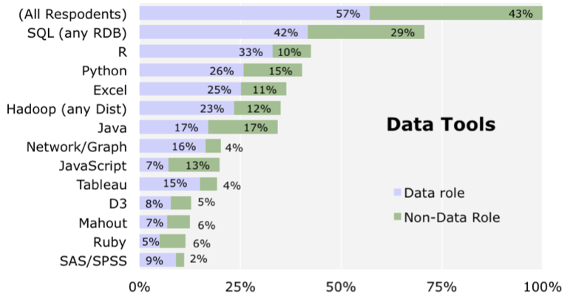
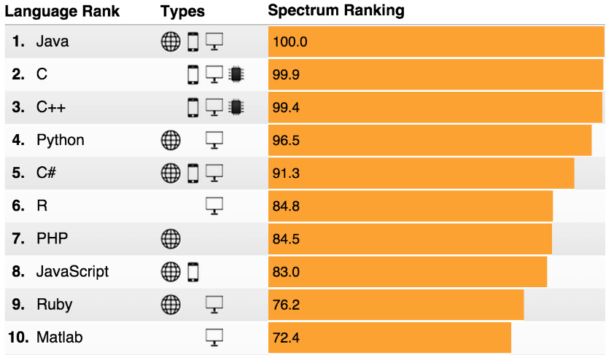
Why R?
Tools for Data Science
Language Popularity
IEEE Spectrum Top Programming Languages
Source: O’Reilly Data Science Survey
R moved from 9th place (2014) into 6th!!
IEEE Spectrum, July 2015

Slide 6

The R Ecosystem
The r-project: an open source project
R core group (20 developers) guides the evolution of the language
R is administered and by the R Foundation
The R Community contributes new packages
The R Consortium supports the community

Slide 7
The R Package System
New features are added to the R language through the R package system
R Packages are collections of R functions, data, and compiled code. While R comes with a set of packages by default, there are many more packages that can be added to extend the capabilities of R. Experts in every domain have made resources, applications and code available for free, online.
Browse for packages by name, author, title, and published date or find packages organized by task.

Slide 8
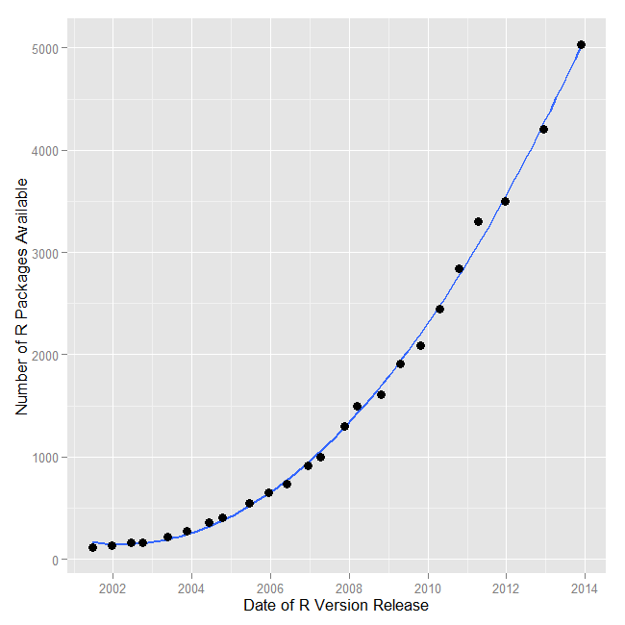
R Growth
Put this astonishing growth in perspective:
SAS.V 9.3S contains ~ 1,200 commands that are roughly equivalent to R functions
R packages contain a median of 5 functions
Therefore R has ~ 36,820 functions
During 2013 alone, R added more functions than SAS Institute has written in its entire history!
Bob Muenchen

Slide 9
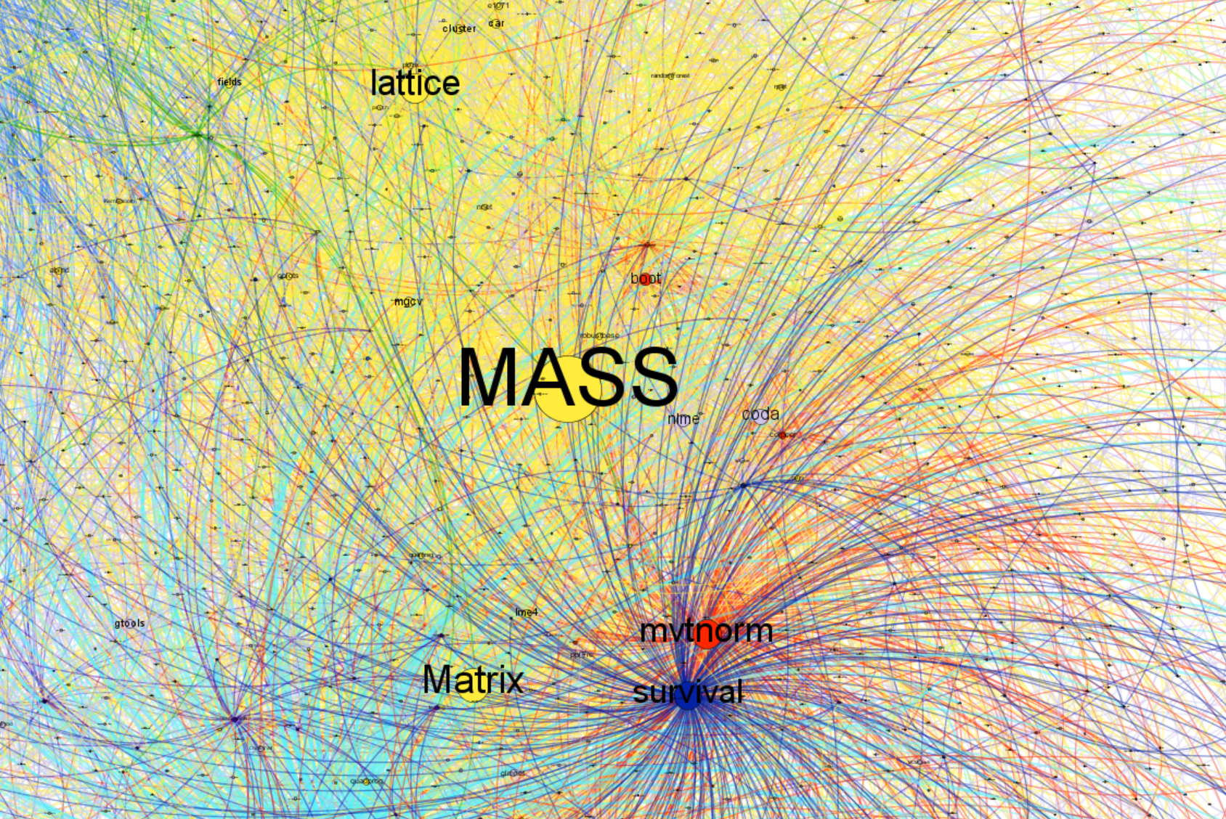
Notes:
MASS Matrix lattice mgcv Hmisc cluster car xtable fields lme4 abind e1071 gplots robustbase quadprog nnet plotrix randomForest rpart quantreg
mvtnorm boot numDeriv corpcor multcomp VGAM optimx Rsolnp BB expm SpatialVx sm truncnorm Crossover tmvtnorm drsmooth bbmle list BANFF QRM
survival rms NSM3 coin prodlim survMisc plsRcox Biograph date pec mets riskRegression rsig lava sprinter missDeaths flexsurv etm LogicReg timereg

Slide 10
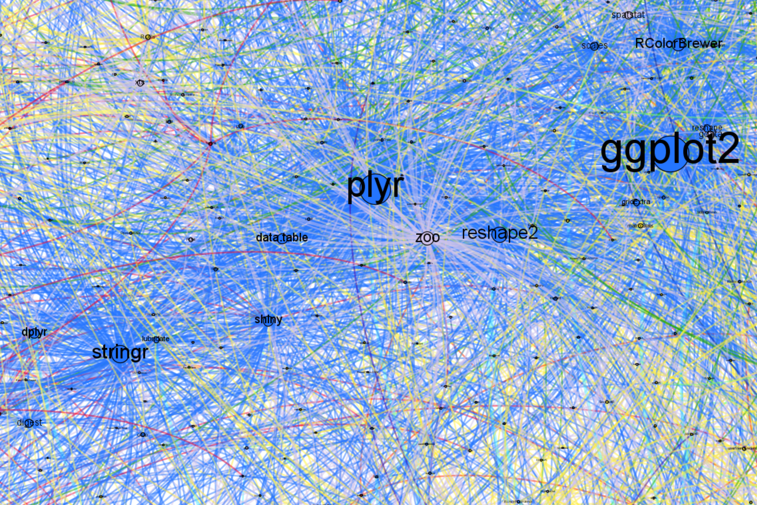
Notes:
ggplot2 plyr stringr reshape2 RColorBrewer shiny data.table dplyr digest scales reshape DBI lubridate gridExtra scatterplot3d vmsbase qdap png RSQLite FactoMineR

Slide 11
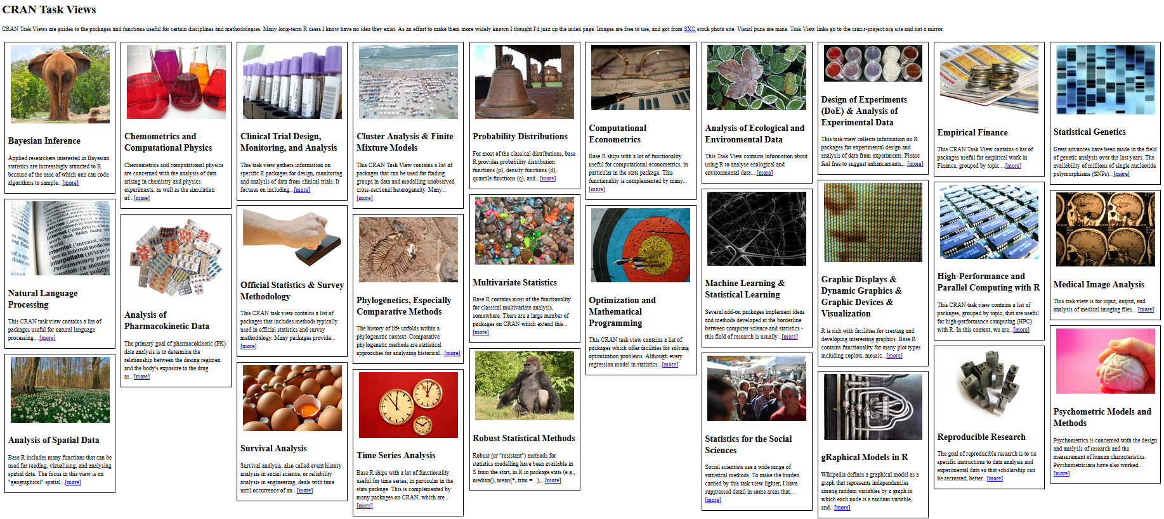
R packages are organized into Task Views

Slide 12
What’s your goal in learning R?
Levels of R Skill
Write production grade code
Write an R package
Write code and algorithms
Use R functions
Use a GUI
R developer
R contributor
R programmer
R user
R aware
10
10,000
Hours of use
The Malcolm Gladwell “Outliers” Scale

Slide 13
Let’s Look at R

Slide 14
Scaling up with RRE and Azure

Slide 15

Revolution R Enterprise
RRE is a distribution of the R language designed for Distributed Computing with Big Data
Start with open source R
Recompile with the Intel MKL
Add a distributed computing layer to go underneath R that runs across multiple big data platforms
Add a suite of custom Parallel External Memory Algorithms
Notes:
Enterprise readiness
Performance architecture
Big Data analytics
Data source integration
Development tools
Deployment tools

Slide 16

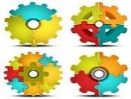








ScaleR Functions & Algorithms
Data Step
Statistical Tests
Variable Selection
Data import – Delimited, Fixed, SAS, SPSS, OBDC
Variable creation & transformation
Recode variables
Factor variables
Missing value handling
Sort, Merge, Split
Aggregate by category (means, sums)
Chi Square Test
Kendall Rank Correlation
Fisher’s Exact Test
Student’s t-Test
Stepwise Regression
Simulation
Sampling
Simulation (e.g. Monte Carlo)
Parallel Random Number Generation
Subsample (observations & variables)
Random Sampling
Cluster Analysis
Descriptive Statistics
Predictive Models
Min / Max, Mean, Median (approx.)
Quantiles (approx.)
Standard Deviation
Variance
Correlation
Covariance
Sum of Squares (cross product matrix for set variables)
Pairwise Cross tabs
Risk Ratio & Odds Ratio
Cross-Tabulation of Data (standard tables & long form)
Marginal Summaries of Cross Tabulations
K-Means
Sum of Squares (cross product matrix for set variables)
Multiple Linear Regression
Generalized Linear Models (GLM) exponential family distributions: binomial, Gaussian, inverse Gaussian, Poisson, Tweedie. Standard link functions: cauchit, identity, log, logit, probit. User defined distributions & link functions.
Covariance & Correlation Matrices
Logistic Regression
Classification & Regression Trees
Predictions/scoring for models
Residuals for all models
Classification
Decision Trees
Decision Forests
Gradient Boosted Decision Trees
Naïve Bayes
Combination
PEMA-R API
rxDataStep
rxExec

Slide 17
Some Resources for Continued Learning

Slide 18
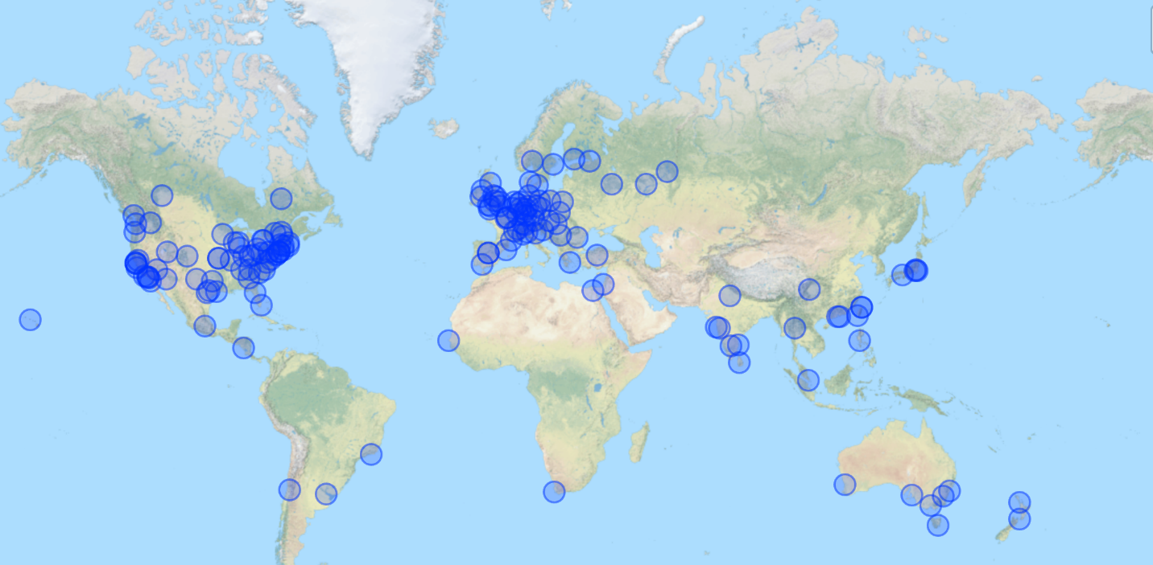
R User Groups Are Everywhere 166 RUGS Worldwide
http://blog.revolutionanalytics.com/2015/06/r-user-groups-are-everywhere.html

Slide 19
R Resources
John Chambers and Trevor Hastie discuss history of A and R: http://bit.ly/1NVnQWQ
Download RRO and search for packages: mran.revolutionanalytics.com
Revolutions blog: http://blog.revolutionanalytics.com/ RBloggers: http://www.r-bloggers.com
New R packages and news on updated packages: dirk.eddelbuettel.com/cranberries
Search for R topics on the web: http://www.rseek.org
search or R packages: http://www.rdocumentation.org
A list of R Resources: http://www.revolutionanalytics.com/what-is-open-source-r/r-resources.php
Quick R: http://www.statmethods.net/
R Reference Card: http://cran.r-project.org/doc/contrib/Short-refcard.pdf
An online book: http://www.cookbook-r.com/
Hadley Wickham’s book, Advanced R: http://adv-r.had.co.nz
CRAN Task Views: http://cran.r-project.org/web/views/
Some help with packages: http://crantastic.org/
the BIOCONDUCTOR PROJECT FOR GENOMICS: http://www.bioconductor.org/

Slide 20
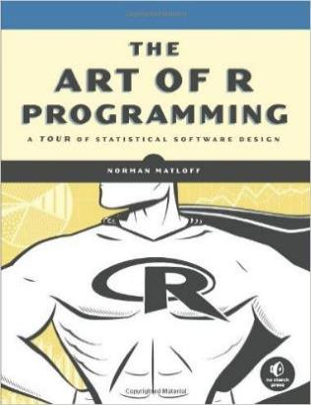
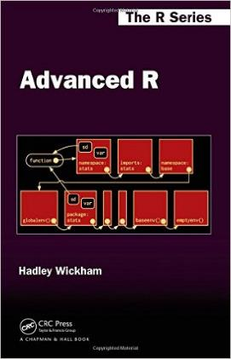
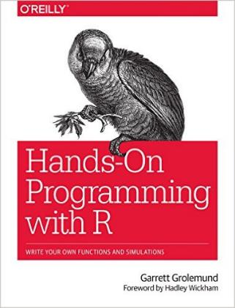
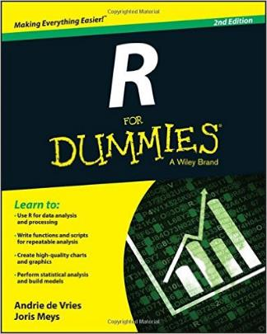
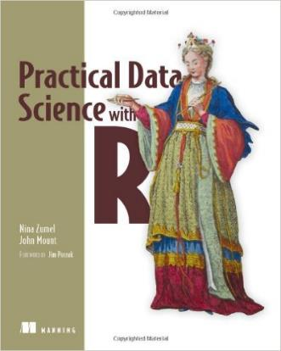
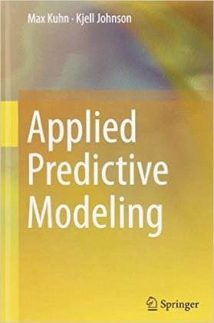
Some Books

Slide 21









A professional organization with corporate members organized under an open source governance and foundation model to support
the R Community
the R Foundation
R developers and users
An independent 501(c)6 non-profit organization under the Linux Foundation

